Slide 1
University of Basrah Al-zahraa college of medicine
Ministry of higher Education and Scientific Researches
Academic year 2020-2021
2nd year S-3
Cardiovascular Module
SGS 4 Date: 30/12/2020
Module staff:
Dr Firas Rashid (Module leader)
Dr Ansam Munadhel
Dr Rehab A. Jaafer Dr Jawad Ramadhan Dr Nawal Mustafa Dr. Nada Hashim Dr Miami Kadhum Dr Khalid Ahmed Dr Nehaya Al-Aubody Dr Amer Qasim Dr Hadeel S. Al Ali Dr Raghda Shaabeen
Dr Hussain Kata Dr Ahmed Hakim

Slide 2
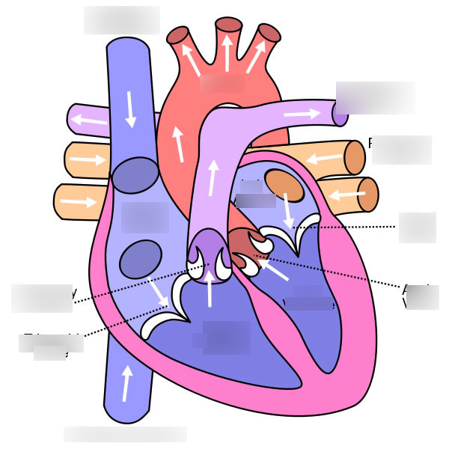
University of Basrah Al-zahraa college of medicine
Ministry of higher Education and Scientific Researches

Slide 3
University of Basrah Al-zahraa college of medicine
Ministry of higher Education and Scientific Researches
The heart as apump
What is the average pressure in the right atrium?
How many action potentials are generated by the cardiac pacemaker at each heartbeat?
How many action potentials are generated by the cardiac pacemaker at each heartbeat?
What is a typical resting heart rate? How much blood is ejected from the left ventricle per beat at rest?

Slide 4
University of Basrah Al-zahraa college of medicine
Ministry of higher Education and Scientific Researches
8. What will happen to the beating of the heart if the sino-atrial node is damaged?
9. Given the heart has more than one pacemaker, why don't different pacemakers
compete to drive the heartbeat in the normal heart?
10. If nerves are to change heart rate where in the heart must they act?
11. If the heart rate is 60 bpm, what is the approximate duration of diastole?

Slide 5
University of Basrah Al-zahraa college of medicine
Ministry of higher Education and Scientific Researches
14. Draw a graph (volume against time) to show the rate of ventricular filling in diastole
15. What proportion of the ventricular filling occurs during the first 100 ms of diastole?
16. Why doesn't the ventricle go on filling at the same rate throughout diastole?
17. What will happen if the venous pressure supplying the atrium rises?

Slide 6
University of Basrah Al-zahraa college of medicine
Ministry of higher Education and Scientific Researches
20. What happens to intraventricular volume just after the A/V valves close?
21. What will happen if the valve becomes incompetent (leaks)?
22. Why does the ventricle not empty completely into the arteries during systole?
23. What will happen if the heart muscle contracts harder?

Slide 7
University of Basrah Al-zahraa college of medicine
Ministry of higher Education and Scientific Researches
24. Why doesn't the aortic valve close as soon as the heart muscle begins to relax?
26. Draw the normal profile of pressure changes in the jugular vein during the cardiac
cycle and label the a, c and v components. What produces these components?

Slide 8
University of Basrah Al-zahraa college of medicine
Ministry of higher Education and Scientific Researches
Autonomic nervous system
Q4-1
If you gave an individual an injection of adrenaline what would happen?
Q4-2
What does an individual with a high circulating level of adrenaline look like to an outside observer?
Q4-3
Some individuals react to bee sting or nettle sting with a massive release of chemical
mediators tending to dilate blood vessels and constrict the airways of the lung. What
substance would you need to inject into some one suffering this 'anaphylaxis' and why?

Slide 9
University of Basrah Al-zahraa college of medicine
Ministry of higher Education and Scientific Researches
Q4-4
List the probable physiological effects of giving an individual a drug which antagonizes the action of noradrenaline at α-adrenoreceptors
Q4-5
A patient with an overactive thyroid gland has an increased sympathetic drive to the heart.
How will the patient’s heart rate and cardiac output differ from normal?

Slide 10
University of Basrah Al-zahraa college of medicine
Ministry of higher Education and Scientific Researches
Q4-6
What will be the physiological effects of giving the patient above a drug which antagonizes the action of adrenaline and noradrenaline at b-adrenoreceptors
Q4-7
Why does your mouth go dry when you are frightened?

Slide 11
University of Basrah Al-zahraa college of medicine
Ministry of higher Education and Scientific Researches
Q4-8
Acetylcholine is removed from synapses by an enzyme - acetylcholinesterase. If this
enzyme is antagonized or inactivated, then excess acetylcholine will accumulate, particularly at parasympathetic post-ganglionic neuro effector junctions. List the physiological effects of a poison which inactivates acetylcholinesterase (such as a nerve gas or insecticide).

Slide 12
University of Basrah Al-zahraa college of medicine
Ministry of higher Education and Scientific Researches
Q4-9
What will an individual poisoned in this way look like?
Q4-10
Which of the physiological changes above are most life threatening and what would
you have to do to keep them alive?
Q4-11
In principle, what sort of drug would you use to limit the autonomic effects of poisoning with an acetylcholinesterase inhibitor?

Slide 13
University of Basrah Al-zahraa college of medicine
Ministry of higher Education and Scientific Researches

